Slide 1
Data cleaning and visualization using data analytics tools: Pandas, numpy and matplotlib

Slide 2
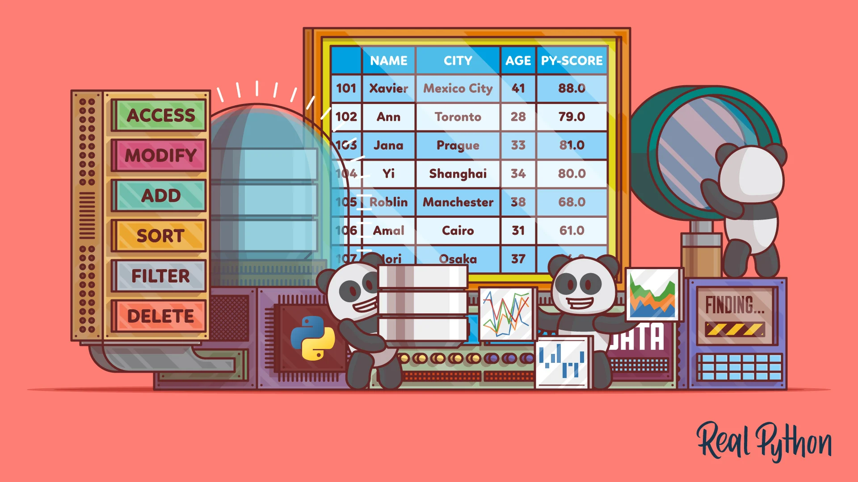
Introduction to Pandas
Pandas is an open-source, BSD-licensed Python library providing high-performance, easy-to-use data structures and data analysis tools for the Python programming language.
Pandas is built on top of NumPy library.
Pandas is well suited for many different of data
Image Source: https://realpython.com/pandas-dataframe/
Notes:
pandas is an open-source, BSD-licensed Python library providing high-performance, easy-to-use data structures and data analysis tools for the Python programming language.
pandas is built on top of NumPy library.
pandas is well suited for many different of data:
Tabular data with heterogeneously-typed columns, as in an SQL table or Excel spreadsheet
Ordered and unordered (not necessarily fixed-frequency) time series data.
Arbitrary matrix data (homogeneously typed or heterogeneous) with row and column labels
Any other form of observational / statistical data sets. The data actually need not be labeled at all to be placed into a pandas data structure

Slide 3
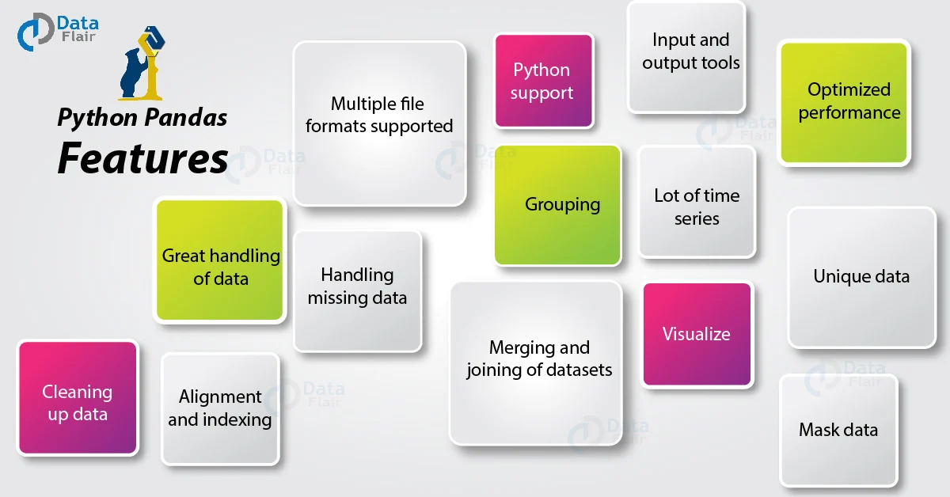
Features of Pandas
Image Source: https://data-flair.training/blogs/python-pandas-features/
Notes:
This slide deals with the features of Pandas:
The key characteristics of Pandas are:
We can import, prepare, modify, model, and analyze data with Pandas, regardless of its origin.
With default and customizable indexing, the Data Frame object is quick and efficient.
Tools for loading data from various file formats into in-memory data objects.
Data alignment and handling of missing data in a unified manner.
Date sets can be reshaped and pivoted.
Slicing, indexing, and sub setting of big data sets depending on labels.
A data structure's columns can be removed or added.
For aggregation and transformations of data, group by function is used .
Data merging and joining with high performance.
Time Series based functionality is one the useful feature of Pandas

Slide 4
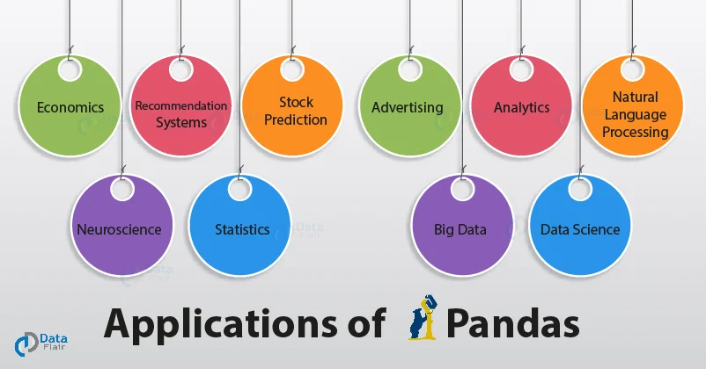
Applications of Pandas
Image Source: https://data-flair.training/blogs/applications-of-pandas/
Notes:
Next is about, different application areas of Pandas
Pandas can be used in many industrial sectors for variety of applications. Some of them are explained as follows:
In Economics: Many modern-day economists use pandas and python to work with large datasets and analyze them. Pandas has a long range of built-in tools and functions that help it to be the effective package it is.
In Neuroscience: Understanding how our brains (and hence the whole nervous system) operate has long been an unrealized dream of doctors since they feel it would aid in the discovery of answers to many of our body's riddles. Machine Learning has greatly aided this subject, thanks to the multiple uses of pandas.
Pandas in Recommendation systems on Online Platforms: Pandas can handle a lot of data, which makes it easier for it to understand the massive amounts of data required to construct a solid recommendation system. These recommendation algorithms need on functions like mapping and GroupBy to function properly.
In statistics: Statistics entails dealing with large amounts of data. As a result, a library like pandas may assist in a variety of ways because it primarily works with various types of data processing and operations. When completing statistical computations, the fundamental functions of mean, median, and mode come in handy. There are a slew of other functions in pandas that might assist you improve your statistics findings.
In Natural language Processing: With pandas and Scikit-Learn at your disposal, you can build a rudimentary NLP model that you can improve later. You may utilize a variety of functions and libraries to assist you.
Due the data handling capability of Pandas, it can be also used in the field of advertising and also for big data analytics
Ref: https://www.studytonight.com/pandas/application-of-pandas-in-data-science-industry

Slide 5
Most commonly used functions in Pandas
read_csv()
head() /head(n)
describe()
memory_usage()
astype()
loc[:]
to_datetime()
value_counts()
drop_duplicates()
groupby()
merge()
sort_values()
fillna()
Notes:
As we discussed Pandas is a library that deals with data and it consist of functions that can handle data
Most commonly used thirteen functions of pandas and its uses are explained here
read_csv() function helps read a comma-separated values (csv) file into a Pandas DataFrame.
head(n) is used to return the first n rows of a dataset. By default, head() will return the first 5 rows of the DataFrame.
describe() is a Pandas DataFrame or Series function that generates descriptive statistics for the data. It describes the dataset's central tendency and dispersion. describe() is useful for quickly acquiring an overview of a dataset.
memory_usage() returns a Pandas Series having the memory usage of each column (in bytes) in a Pandas DataFrame.
The astype() function is used to convert a Python object to a certain data type. It can be a very useful feature if your data isn't saved in the right format.
loc[:] allows us to access a collection of rows and columns in a dataset, or a slice of the dataset, as needed.
to_datetime() is a Python function that transforms a Python object to datetime format.
value counts() produces a Pandas Series with unique value counts.
drop_duplicates() provides a Pandas DataFrame that is free of duplicate entries.
groupby() is a Pandas DataFrame function that groups data by one or more columns and performs a mathematical operation on it. The function groupby() can be used to quickly summarise data.
On a common column, merge() is used to join two Pandas DataFrame objects or a DataFrame and a Series object (field).
Sort columns in a Pandas DataFrame (or a Pandas Series) by values in ascending or descending order with sort values().
Several entries in a big dataset will typically be labelled NaN by Python.
The term "not a number" refers to items that were not filled out in the original data source.
Pandas ensures that these items may be identified independently by the user while populating the data in the DataFrame.
fillna() replaces all NaN values in a DataFrame or Series with more suitable values by imputing these missing values.

Slide 6
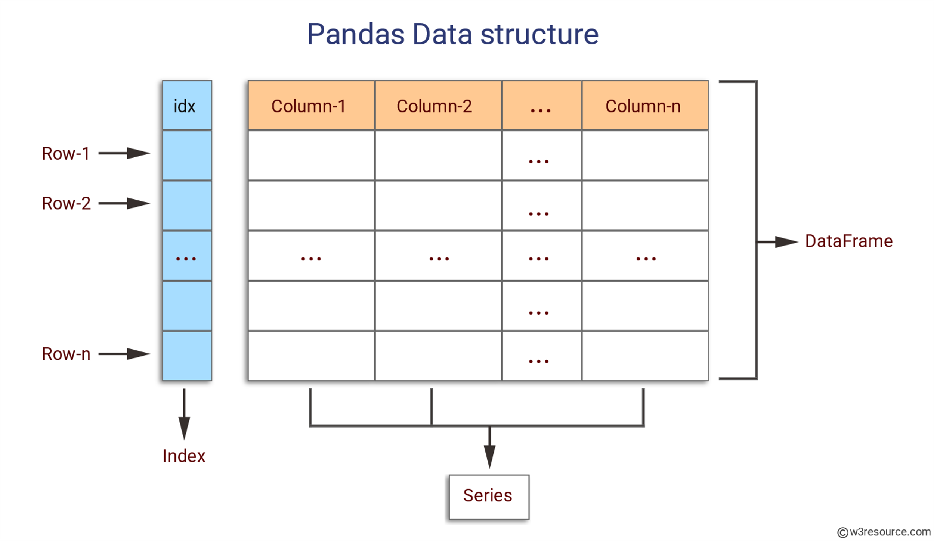
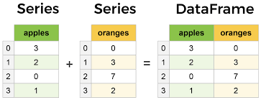
Core components of Pandas : Series and Data Frame
https://www.learndatasci.com/tutorials/python-pandas-tutorial-complete-introduction-for-beginners/
Notes:
The Series and DataFrame are the two most important parts of pandas.
A Series is a multi-dimensional table made up of a collection of Series, while a DataFrame is a multi-dimensional table made up of Series.
DataFrames are the Pandas data type for storing tabular 2D data, and Pandas is the most used data manipulation programme in Python.
The figure represents Pandas series and Data Frame.

Slide 7
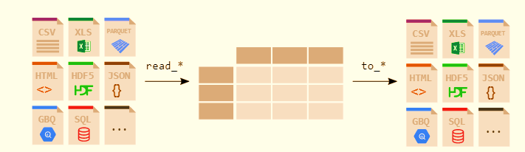
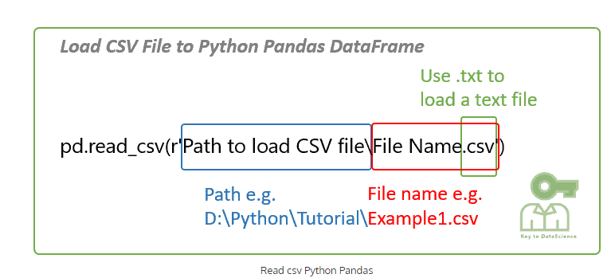
File Handling with Pandas
https://pandas.pydata.org/docs/getting_started/intro_tutorials/02_read_write.html
Notes:
Any analyst or data scientist should be able to read data from CSV files and write data to CSV files using Python.
The read_csv() method in pandas allows you to read data from a csv file into a pandas DataFrame.
Pandas comes with support for a variety of file formats and data sources (csv, excel, sql, json, parquet, and so on), all of which begin with the prefix read_*.

Slide 8
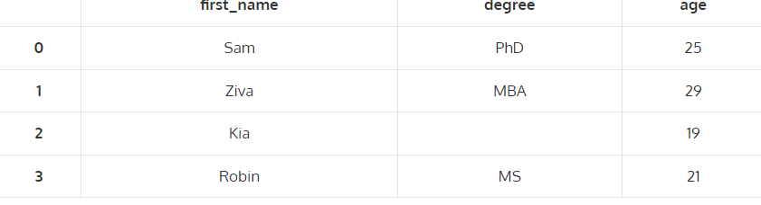
Sample Reading and writing .csv file
import pandas as pd
# Create a dataframe
raw_data = {'first_name': ['Sam','Ziva','Kia','Robin'],
'degree': ['PhD','MBA','','MS'],
'age': [25, 29, 19, 21]}
df = pd.DataFrame(raw_data)
df
#Save the dataframe
df.to_csv(r'Example1.csv')
Output
import pandas as pd
# Read csv file
df = pd.read_csv(r'D:\Python\Tutorial\Example1.csv')
df
Notes:
The sample code for reading and writing of CSV file is shown here
To read the csv file DataFrame you just created to a csv file, Enter the path and filename where the csv file is stored.
You may try this code in Jupyter notebook

Slide 9
Exploring a dataset using Pandas
Download the dataset from: https://drive.google.com/file/d/1q7qK03njlzZRQ7PyYoprn12uVnE1gjH6/view
Import pandas as pd
data_1 = pd.read_csv(r‘<datasetpath>')
data_1.head(6)
data_1.describe()
data_1.memory_usage(deep=True)
data_1['Gender'] = data_1.Gender.astype('category')
data_1.loc[0:4, ['Name', 'Age', 'State']]
data_1['DOB'] = pd.to_datetime(data_1['DOB'])
data_1['State'].value_counts()
data_1.drop_duplicates(inplace=True)
data_1.groupby(by='State').Salary.mean()
data_1.merge(data_2, on='Name', how='left')
data_1.sort_values(by='Name', inplace=True)
data_1['City temp'].fillna(38.5, inplace=True)
Ref: https://www.analyticsvidhya.com/blog/2021/05/pandas-functions-13-most-important/
Notes:
Download the dataset from the link provided and explore the dataset using the popular functions in pandas
The dataset set path along with the csv file name should be specified in the space provided
You may try this in jupyter notebook
https://www.analyticsvidhya.com/blog/2021/05/pandas-functions-13-most-important/

Slide 10
Convert list into series of elements
# convert element lists into series of elements, which have index from 0—5
import pandas as pd
my_data=[10,20,30,40,50]
pd.Series(data=my_data)
import numpy as np
import pandas as pd
d={'a':10,'b':20,'c':30,'d':40}
#dictionary keys act as index and values with every key act as series values
pd.Series(d)
import numpy as np
import pandas as pd
d={'a':10,'b':20,'c':30,'d':40}
#dictionary keys act as index and values with every key act as series values
pd.Series(d)
Convert dictionary into series of elements
Convert dictionary into series of elements
Notes:
The sample code for converting list into list and dictionary series of elements shown here.

Slide 11
Data Manipulation: Drop missing elements
import pandas as pd
import numpy as np
d={'A':[1,2,np.NaN], 'B':[1,np.NaN,np.NaN],'C':[1,2,3]}
# np.NaN is the missing element in DataFrame
df=pd.DataFrame(d)
df.dropna() #pandas would drop any row with missing value
df.dropna(axis=1) #drop column with NULL value
Notes:
The sample code for dropping missing values by dropping corresponding row or column is shown here
Here np.NaN is the missing element in DataFrame

Slide 12
Data Manipulation: Filling suitable value
df.fillna(value='FILL VALUE') #NaN is replaced by value=FILL VALUE
df['A'].fillna(value=df['A'].mean())
#Select column "A" and fill the missing value with mean value of the column A
df['A’].fillna(value=df['A’].std())
#Select column "A" and fill the missing value with standard deviation value of the column A
Notes:
The code shown here is to fill the missing value with a particular value or
by Selecting column "A" and fill the missing value with mean value of the column A or
By Selecting column "A" and fill the missing value with standard deviation value of the column A

Slide 13
Replacing a value
import pandas as pd
df = pd.DataFrame({'one':[10,20,30,40,50,2000], 'two':[1000,0,30,40,50,60]})
print df.replace({1000:10,2000:60})
Notes:
Many times, we have to replace a generic value with some specific value.
We can achieve this by applying the replace method.
Replacing NA with a scalar value is equivalent behavior of the fillna() function.
In this case 1000 is replaced with 10 and 2000 is replaced with 60 using replace method.

Slide 14
Groupby() function
data = {'Company’: [ ‘CompA’, ‘CompA’, ‘CompB’, ‘CompB’, ‘CompC’, ‘CompC’],
'Person’: [‘Rajesh’, ‘Pradeep’, ‘Amit’, ‘Rakesh’, ‘Suresh’, ‘Raj’],
'Sales’: [200, 120, 340, 124, 243, 350]}
df=pd.DataFrame(data)
df
comp=df.groupby("Company").mean()
comp
comp1=df.groupby("Company") #grouping done using label name “Company”
comp1.std() #apply standard deviation on grouped data
Notes:
The groupby() function divides data into groups depending on a set of criteria.
Any of the axes can be used to separate pandas objects. Grouping is defined as a mapping of labels to group names in its most basic form.
In the code provided here, grouping based on company name and applying statistics like Mean or standard deviation to the grouped data is performed.

Slide 15
Finding maximum value in each label
data = {'Company’: [ ‘CompA’, ‘CompA’, ‘CompB’, ‘CompB’, ‘CompC’, ‘CompC’],
'Person’: [‘Rajesh’, ‘Pradeep’, ‘Amit’, ‘Rakesh’, ‘Suresh’, ‘Raj’],
'Sales’: [200, 120, 340, 124, 243, 350]}
df=pd.DataFrame(data)
df
df.groupby("Company").max()
Notes:
Here the dataset is grouped based on ‘company’ label and pick maximum value in each label

Slide 16
Finding unique value & number of occurrence from Dataframe
df = pd.DataFrame({'col1':[1,2,3,4],'col2':[444,555,666,444],'col3':['abc','def','ghi','xyz’]})
# col1, col2 & col3 are column labels, each column have their own values
df['col2'].unique() #fetches the unique values available in column
df['col2'].value_counts() # count number of occurrence of every value
Notes:
The code provided here:
fetches the unique values available in column 2
count number of occurrence of every value in column 2

Slide 17
Statistical Functions
import numpy as np
import pandas as pd
s = pd.Series([1,2,3,4,5,4])
print s.pct_change()
df = pd.DataFrame(np.random.randn(5, 2))
print df.pct_change()
s1 = pd.Series(np.random.randn(10))
s2 = pd.Series(np.random.randn(10))
print s1.cov(s2) import numpy as np
frame = pd.DataFrame(np.random.randn(10, 5), columns=['a', 'b', 'c', 'd', 'e'])
print frame['a'].corr(frame['b'])
print frame.corr()
s = pd.Series(np.random.randn(5), index=list('abcde'))
s['d'] = s['b'] # so there's a tie
print s
print s.rank()
Notes:
The code provided here is to perform certain statistical functions explained as follows:
The pct_change() function compares every element with its prior element and computes the change percentage.
Covariance is applied on series data. The Series object has a method cov() to compute covariance between series objects. NA will be excluded automatically.
Correlation shows the linear relationship between any two array of values, available in series.
There are multiple methods to compute the correlation like pearson(default), spearman and kendall
Data Ranking produces ranking for each element in the array of elements; ;arge value assigned higher rank.
In case of ties, assigns the mean rank.

Slide 18
Data Analytics Tools : Numpy

Slide 19
Introduction
NumPy is the core library for scientific computing in Python.
It contains among other things:
a powerful N-dimensional array object and tools for working with these arrays
sophisticated (broadcasting) functions
tools for integrating C/C++ and Fortran code
useful linear algebra, Fourier transform, and random number capabilities
Besides its obvious scientific uses, NumPy can also be used as an efficient multi-dimensional container of generic data.
Notes:
Like Pandas Numpy is also a core library for scientific computing in Python.
It contains among other things:
a powerful N-dimensional array object and tools for working with these arrays
sophisticated (broadcasting) functions
tools for integrating C/C++ and Fortran code
useful linear algebra, Fourier transform, and random number capabilities
Besides its obvious scientific uses, NumPy can also be used as an efficient multi-dimensional container of generic data.

Slide 20
What is the need of Numpy?
List is powerful, collection of values
Hold different types and you can change, add or remove elements from the list
But for data scientist you need to apply operations on entire array
Mathematical operations on entire collection of data set/list/arrays
Speed Solution is numpy (numerical python): you can perform operations on entire arrays.
Notes:
NumPy arrays are more compact and faster than Python lists.
An array uses less memory and is easier to work with.
NumPy stores data in a substantially smaller amount of memory and has a way for specifying data types.
This enables for even more code optimization.

Slide 21
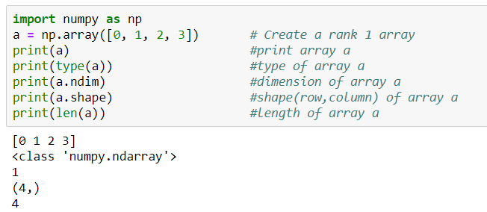
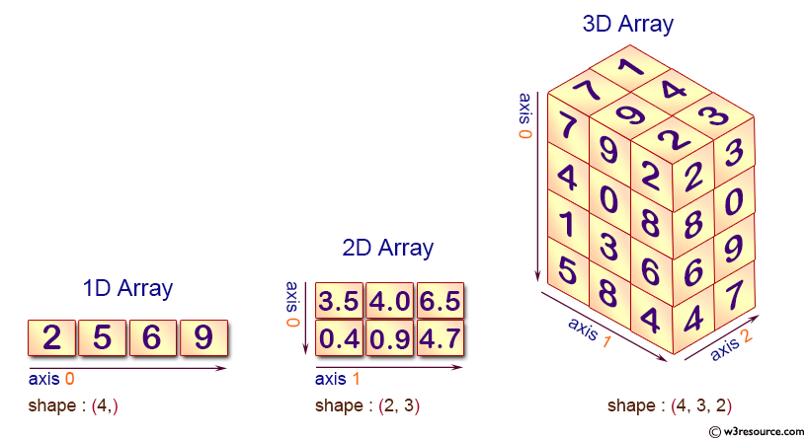
Numpy Array
Scalar
Vector
Matrix
Tensor
Notes:
A numpy array is a grid of identical-type values indexed by a tuple of nonnegative integers.
The array's rank is the number of dimensions;
the shape is a tuple of numbers indicating the array's size along each dimension.

Slide 22
Working with array’s in Numpy
Create 2-D array using numpy from list
import numpy as np
mylist=[[1,2,3],[4,5,6],[7,8,9]]
np.array(mylist)
Create 1-D and 2-D array using random values
np.random.rand(5) #uniform distribution of random values
np.random.rand(4,4) # create 2-D array of random values
np.random.randn(4) #std. normal distribution, centered around 0
Notes:
Sample code for creating two Dimensional arrays from a list and also using random values are shown here

Slide 23
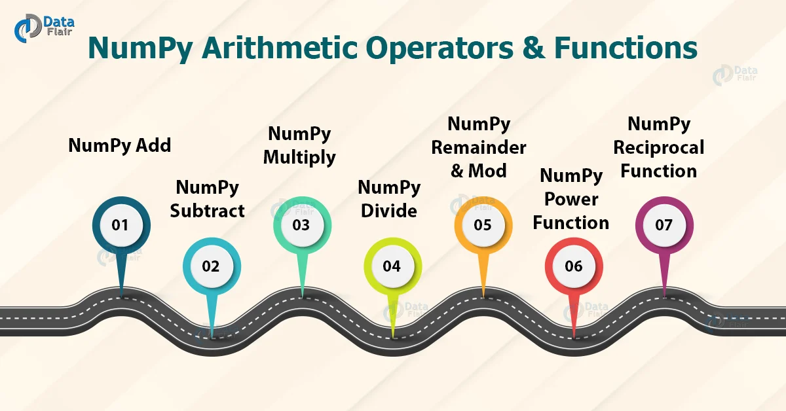
Numpy Numerical Operations
Add- np.add(a, b)
Subtract- np.subtract(a, b)
Multiply- np.multiply(a, b)
Divide- np.divide(a, b)
Remainder - np.remainder(a,b)
Modulus - np.mod(a,b)
Power- np.power(a,b)
Reciprocal- np.reciprocal(a)
https://data-flair.training/blogs/numpy-arithmetic-operations/
Notes:
The conventional arithmetic procedures in Python are extensive. These operations aid in the execution of basic addition, subtraction, multiplication, and division operations. In NumPy, there are functions for performing arithmetic operations. Let's take a look at NumPy's arithmetic operations and functions.

Slide 24
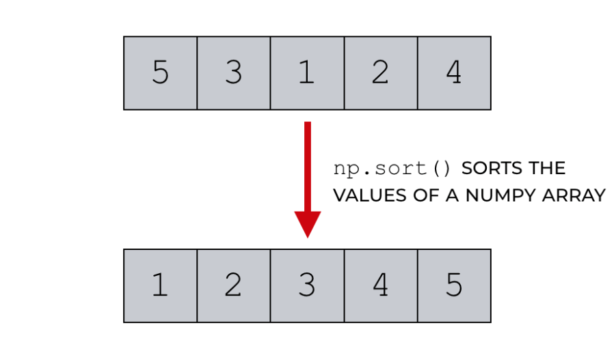
Numpy methods & attributes
np.array()
np.random.randint(0,10,1)
np.unique()
np.dot()
np.power(a,2)
np.sqrt(a)
np.ones()
np.zeros()
np.max()
np.arange(10)
a.size
a.ndim
a.dtype
a.shape
Notes:
Array methods and attributes are used perform various operations.
Attributes reflect information that is intrinsic to the array itself.
Generally, accessing an array through its attributes allows you to get and sometimes set intrinsic properties of the array without creating a new array.
Commonly used Numpy methods and attributes are shown here.

Slide 25
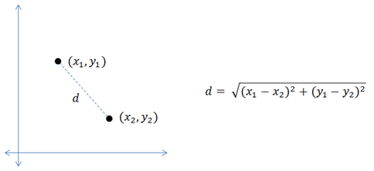
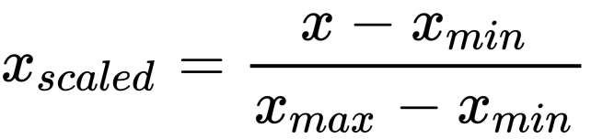
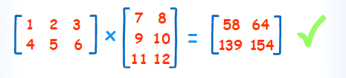
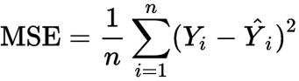
Numpy Operations
1. Euclidean Distance
2. Normalization using Min Max Scalar
3. Matrix Multiplication (Dot Product)
4. Mean Squared Error
Notes:
Numpy operations such as Calculation of Euclidian Distance, Normalization using min max scaler, Matrix multiplication , computation of Mean squared error are shown here.

Slide 26
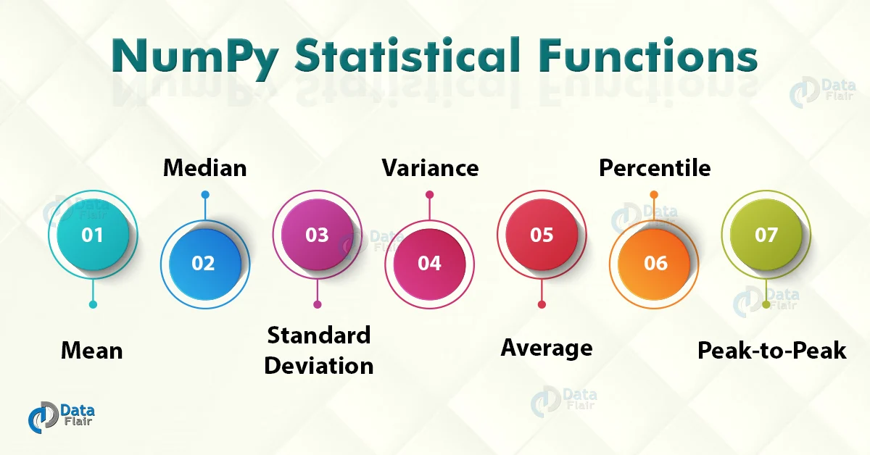
Numpy: Statistical Functions
1. np.amin()- This function determines the minimum value of the element along a specified axis. 2. np.amax()- This function determines the maximum value of the element along a specified axis. 3. np.mean()- It determines the mean value of the data set. 4. np.median()- It determines the median value of the data set. 5. np.std()- It determines the standard deviation 6. np.var – It determines the variance. 7. np.ptp()- It returns a range of values along an axis. 8. np.average()- It determines the weighted average 9. np.percentile()- It determines the nth percentile of data along the specified axis.
https://data-flair.training/blogs/numpy-statistical-functions/
Notes:
The field of statistics is concerned with gathering and interpreting data. It covers procedures for collecting samples, describing data, and concluding the data. NumPy is the core package for scientific calculations, hence NumPy statistical Functions go hand-in-hand with it.
NumPy has a number of statistical functions for performing statistical data analysis. When looking for a maximum or minimum of elements, these statistical functions come in handy. It can also be used to figure out basic statistical concepts like standard deviation and variance.
Various Statistical Functions in NumPy are:
np.amin()- This function determines the minimum value of the element along a specified axis. 2. np.amax()- This function determines the maximum value of the element along a specified axis. 3. np.mean()- It determines the mean value of the data set. 4. np.median()- It determines the median value of the data set. 5. np.std()- It determines the standard deviation 6. np.var – It determines the variance. 7. np.ptp()- It returns a range of values along an axis. 8. np.average()- It determines the weighted average 9. np.percentile()- It determines the nth percentile of data along the specified axis.

Slide 27


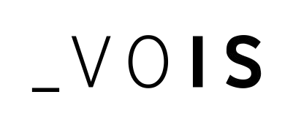

Data Analytics and Machine Learning Foundation

Slide 28
Introduction to Matplotlib
“We humans are typical visual creatures: we understand things better when we see things visualized”
To make necessary statistical inferences, it becomes necessary to visualize your data and Matplotlib is one such solution for the Python users.
matplotlib.pyplot is a plotting library used for 2D graphics in python programming language. It can be used in python scripts,
shell, web application servers and other graphical user interface toolkits.
It is a very powerful plotting library useful for those working with Python and NumPy.
Notes:
Matplotlib is a Python 2D plotting library which produces publication quality figures in a variety of hardcopy formats and interactive environments across platforms.
Matplotlib can be used in Python scripts, the Python and IPython shells, the Jupyter notebook, web application servers, and four graphical user interface toolkits.
can generate plots, histograms, power spectra, bar charts, errorcharts, scatterplots, etc., with just a few lines of code.

Slide 29
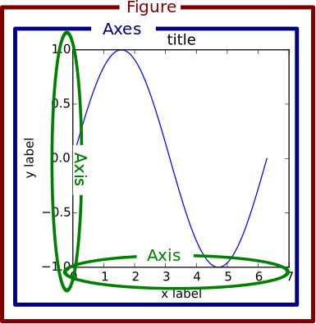
Matplotlib Figure Components
A Matplotlib figure can be categorized into several parts as below:
Figure
Axes
Axis
Artist
Notes:
A Matplotlib figure can be categorized into several parts as below:
Figure
Axes
Axis
Artist
Each component is marked in the diagram with the corresponding correct of text

Slide 30
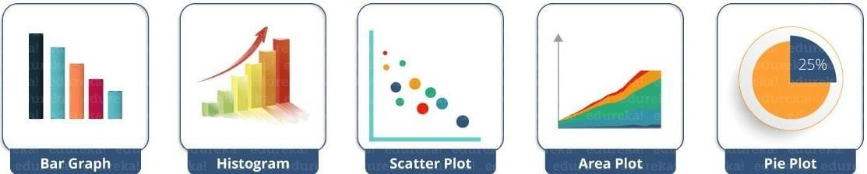
Common matplotlib.pyplot Functions
plot() – plot lines or markers to axes
scatter() – makes scatter plot for X vs Y
bar() – makes a bar graph
barh() – makes a horizontal bar graph
hist() – plot a histogram
hist2d() – make a 2D histogram plot
boxplot() – make a box and whisker plot
pie() – plot a pie graph
Notes:
Pyplot is a state-based interface to a MATLAB-like Matplotlib module.
Line Plot, Contour, Histogram, Scatter, 3D Plot, and others are some of the plots available in Pyplot.
The functions used to plot various types of charts are shown here

Slide 31
Common Axis Functions
axes() – add axes to figure
text() – add text to axes
title() – set title of current axes
xlabel() & ylabel() – set x-axis or y-axis label for current axes
xlim() & ylim() – set x or y limits of current axes
xscale() & yscale() – set the scaling for x-axis or y-axis
xticks() & yticks() – set x or y limits of current tick locations and labels
Notes:
This function is used to set some axis properties to the graph are shown here
xmin, xmax, ymin, ymax: These parameters can be used to set the axis limits on the graph

Slide 32
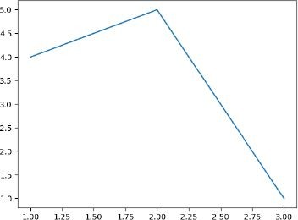
Example Plot
from matplotlib import pyplot as plt #Plotting to our canvas plt.plot([1,2,3],[4,5,1])
#Showing what we plotted
plt.show()
Notes:
The program depicted here is to draw a simple plot using given values

Slide 33
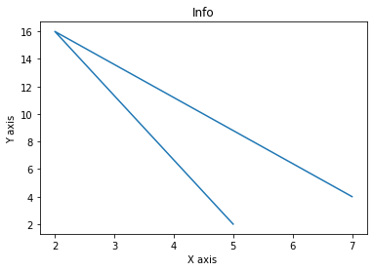
Example Plot: Xlabel, Ylabel and Title
from matplotlib import pyplot as plt x = [5,2,7]
y = [2,16,4]
plt.plot(x,y)
plt.title('Info')
plt.ylabel('Y axis') plt.xlabel('X axis')
plt.show()
Notes:
The program depicted here is to plot a graph with Title of the plot , X axis label and Y axis Label

Slide 34
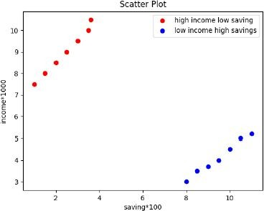
Example Scatter Plot
import matplotlib.pyplot as plt x = [1,1.5,2,2.5,3,3.5,3.6]
y = [7.5,8,8.5,9,9.5,10,10.5]
x1=[8,8.5,9,9.5,10,10.5,11]
y1=[3,3.5,3.7,4,4.5,5,5.2]
plt.scatter(x,y, label='high income low saving',color='r') plt.scatter(x1,y1,label='low income high savings',color='b')
plt.title('Scatter Plot’)
plt.xlabel('saving*100')
plt.ylabel('income*1000’)
plt.legend()
plt.show()
Notes:
The program depicted here is to plot a scatter plot with given set of values and specified colors such as red and blue

Slide 35
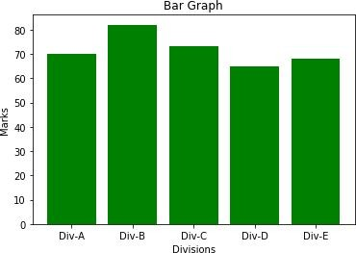
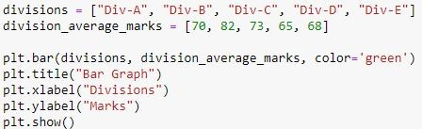
Example Bar Graph
Notes:
The program depicted here is to draw a green color filled bar graph with given set of values
A bar plot or bar graph is a graph that uses rectangular bars with lengths and heights proportionate to the values they reflect to depict a category of knowledge. Bar plots are frequently arranged vertically or horizontally.

Slide 36
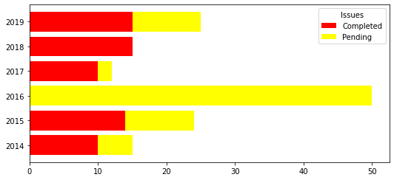
Example Bar Graph (Stacked Horizontally)
from matplotlib import pyplot as plt
plt.rcParams["figure.figsize"] = [7.50, 3.50]
plt.rcParams["figure.autolayout"] = True
year = [2014, 2015, 2016, 2017, 2018, 2019]
issues_addressed = [10, 14, 0, 10, 15, 15]
issues_pending = [5, 10, 50, 2, 0, 10]
b1 = plt.barh(year, issues_addressed, color="red")
b2 = plt.barh(year, issues_pending, left=issues_addressed, color="yellow")
plt.legend([b1, b2], ["Completed", "Pending"], title="Issues", loc="upper right")
plt.show()
https://www.tutorialspoint.com/horizontal-stacked-bar-chart-in-matplotlib
Notes:
To plot stacked bar chart in Matplotlib, we can use barh() methods

Slide 37
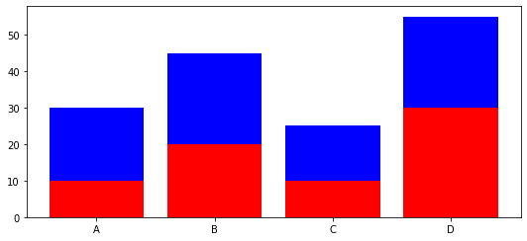
Example Bar Graph (Stacked Vertically)
# importing package
import matplotlib.pyplot as plt
# create data
x = ['A', 'B', 'C', 'D']
y1 = [10, 20, 10, 30]
y2 = [20, 25, 15, 25]
# plot bars in stack manner
plt.bar(x, y1, color='r')
plt.bar(x, y2, bottom=y1, color='b')
plt.show()
https://www.geeksforgeeks.org/create-a-stacked-bar-plot-in-matplotlib/
Notes:
Different groups are represented by stacked bar plots on top of one another. The height of the resulting blend of the groups' results determines the bar's apex. Rather than going from zero to value, it moves from the bottom to the top.

Slide 38
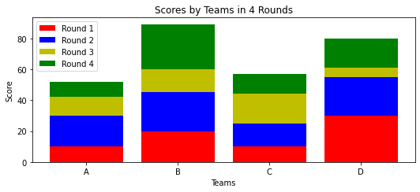
Stacked bar chart with more than 2 data
# importing package
import matplotlib.pyplot as plt
import numpy as np
# create data
x = ['A', 'B', 'C', 'D']
y1 = np.array([10, 20, 10, 30])
y2 = np.array([20, 25, 15, 25])
y3 = np.array([12, 15, 19, 6])
y4 = np.array([10, 29, 13, 19])
# plot bars in stack manner
plt.bar(x, y1, color='r')
plt.bar(x, y2, bottom=y1, color='b')
plt.bar(x, y3, bottom=y1+y2, color='y')
plt.bar(x, y4, bottom=y1+y2+y3, color='g')
plt.xlabel("Teams")
plt.ylabel("Score")
plt.legend(["Round 1", "Round 2", "Round 3", "Round 4"])
plt.title("Scores by Teams in 4 Rounds")
plt.show()
https://www.geeksforgeeks.org/create-a-stacked-bar-plot-in-matplotlib/
Notes:
The sample program for plotting bar charts with more than two data is shown here

Slide 39
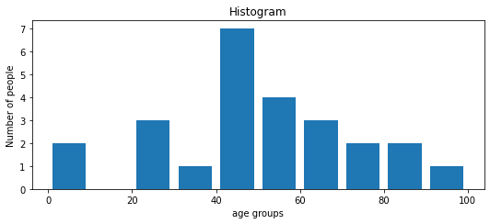
Histogram
import matplotlib.pyplot as plt
population_age = [22,55,62,45,21,22,34,42,42,4,2,102,95,85,55,110,120,70,65,55,111,115, 80,75,65,54,44,43,42,48]
bins = [0,10,20,30,40,50,60,70,80,90,100]
plt.hist(population_age, bins, histtype='bar', rwidth=0.8)
plt.xlabel('age groups')
plt.ylabel('Number of people')
plt.title('Histogram')
plt.show()
Notes:
A sample program for plotting histogram is shown here
A histogram is a visual representation of data that is organised into groups. It is a precise way for displaying numerical data distribution graphically. It's a sort of bar plot in which the X-axis shows bin ranges and the Y-axis represents frequency. To make a histogram, first establish a bin for the ranges, then divide the entire range of values into a series of intervals and count the values that fall into each interval. Bins are defined as non-overlapping, successive intervals of variables. To compute and create a histogram of x, use the matplotlib.pyplot.hist() function.

Slide 40
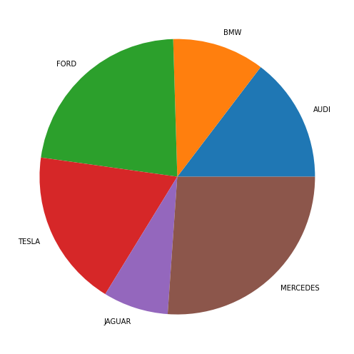
Pie-Chart
# Import libraries
from matplotlib import pyplot as plt
import numpy as np
# Creating dataset
cars = ['AUDI', 'BMW', 'FORD’, 'TESLA', 'JAGUAR', 'MERCEDES']
data = [23, 17, 35, 29, 12, 41]
# Creating plot
fig = plt.figure(figsize =(10, 7))
plt.pie(data, labels = cars)
# show plot
plt.show()
https://www.geeksforgees.orgk/plot-a-pie-chart-in-python-using-matplotlib/
Notes:
An example Pie chart is shown here.
A Pie Chart is a circular statistical layout that can only show one data series. The overall percentage of the given data is represented by the chart's area. The percentage of parts of the data is represented by the area of the pie slices. Pie wedges are the slices of the pie. The length of the wedge's arc determines the area of the wedge. The area of a wedge represents the fraction of the data that belongs to that segment. Because they provide a brief summary, pie charts are often used in business presentations such as sales, operations, survey findings, and resources. The pyplot module of the Matplotlib API offers a pie() method that creates a pie chart representing the data in an array.

Slide 41
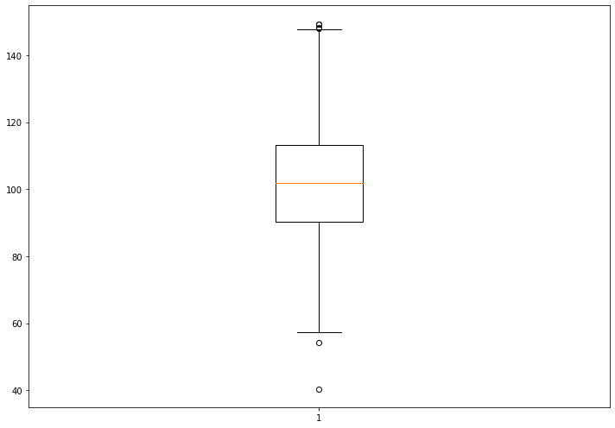
Box Plot
# Import libraries
import matplotlib.pyplot as plt
import numpy as np
# Creating dataset
np.random.seed(10)
data = np.random.normal(100, 20, 200)
fig = plt.figure(figsize =(10, 7))
# Creating plot
plt.boxplot(data)
# show plot
plt.show()
https://www.geeksforgeeks.org/box-plot-in-python-using-matplotlib/
Notes:
A Box Plot, also known as a Whisker Plot, is used to show a summary of a group of data values with features such as minimum, first quartile, median, third quartile, and maximum. A box is drawn from the first quartile to the third quartile in the box plot, and a vertical line runs through the box at the median. The data to be plotted is represented by the x-axis, while the frequency distribution is shown by the y-axis. The matplotlib.pyplot module of the matplotlib library has a boxplot() method that can be used to make box plots.

Slide 42
3D Plotting
To use this functionality, we first import the module mplot3d as follows:
from mpl_toolkits import mplot3d
Once the module is imported, a three-dimensional axes is created by passing the keyword
projection='3d' to the axes() method of Pyplot module. Once the object instance is created, we pass our arguments to 3D method.
Notes:
Matplotlib was created with simply two-dimensional charting in mind. However, at the time of 1.0's release, 3d utilities were being created on top of 2d, and therefore we now have 3d data implementation! Importing the mplot3d toolbox enables the 3d plots. We will use matplotlib to create 3d graphs in this article. The simplest three-dimensional graph is a graph with lines and points. The functions ax.plot3d and ax.scatter plot line and point graphs, respectively.

Slide 43
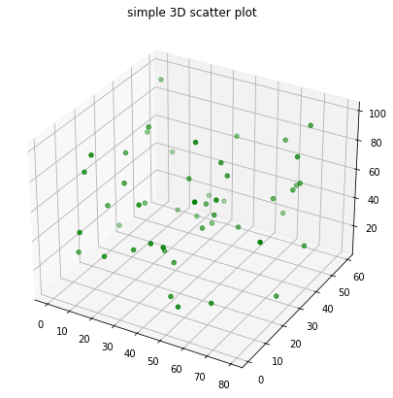
3D Plotting
# Import libraries
from mpl_toolkits import mplot3d
import numpy as np
import matplotlib.pyplot as plt
# Creating dataset
z = np.random.randint(100, size =(50))
x = np.random.randint(80, size =(50))
y = np.random.randint(60, size =(50))
# Creating figure
fig = plt.figure(figsize = (10, 7))
ax = plt.axes(projection ="3d")
# Creating plot
ax.scatter3D(x, y, z, color = "green")
plt.title("simple 3D scatter plot")
Notes:
The sample code for creating a 3D plot is shown here

Slide 44
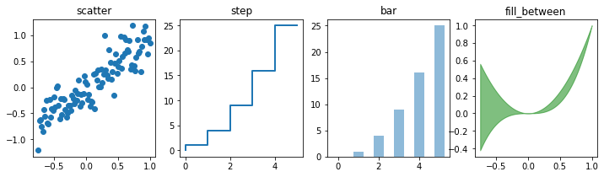
Plot different variety of graphs as subplots
import numpy as np
import matplotlib.pyplot as plt
%matplotlib inline
n = np.array([0,1,2,3,4,5])
xx = np.linspace(-0.75, 1., 100)
fig, axes = plt.subplots(1, 4, figsize=(12,3))
axes[0].scatter(xx, xx + 0.25*np.random.randn(len(xx)))
axes[0].set_title("scatter")
axes[1].step(n, n**2, lw=2)
axes[1].set_title("step")
axes[2].bar(n, n**2, align="center", width=0.5, alpha=0.5)
axes[2].set_title("bar")
axes[3].fill_between(xx, xx**2, xx**3, color="green", alpha=0.5);
axes[3].set_title("fill_between");
Notes:
Subplots are axes that can be found together in a single Matplotlib figure. The matplotlib library's subplots() function aids in the creation of numerous subplot layouts. It gives you complete control over all of the plots you've made.
The code explained here is to plots different variety of graphs as subplots.

Slide 45
Thank you

